Slide 1
What is “research”? Ann Scott Hanks

Slide 2
Research comprises "creative work undertaken on a systematic basis in order to increase the stock of knowledge, including knowledge of man, culture and society, and the use of this stock of knowledge to devise new applications."^{[1]} It is used to establish or confirm facts, reaffirm the results of previous work, solve new or existing problems, support theorems, or develop new theories…Approaches to research depend on epistemologies, which vary considerably both within and between humanities and sciences. There are several forms of research: scientific, humanities, artistic, economic, social, business, marketing, practitioner research, etc.
From Wikipedia

Slide 3
Research Skills & Critical Thinking
Research and critical thinking go hand in hand. They both allow you to pursue your interest, learn something new, to hone your problem-solving skills and to challenge yourself using higher order thinking skills. An accumulation of information is not research at all. We have to engage in reflective and independent thinking, using the information that is found during the research process, to identify and understand the relevance and importance of ideas. Research is no longer limited to a library, museum, or in a laboratory. Now, research is available right at our fingertips. Digital content is so prevalent that the skills of critical thinking, problem-solving, dissemination, and analysis of such content is essential. Use the tools in this issue to help your students locate and make sense of the wealth of information that can be found without ever stepping foot outside the classroom.
From PL Post March 14, 2014

Slide 5
The Research Steps are:
#1: Define the Problem/Ask a Question-What is puzzling?
#2: Review the Evidence-What have others found out?
#3: Develop a Hypothesis or Thesis Statement-What is my guess? What do I think?
#4: Choose a Research Method-How am I going to collect data? What research technique is best to use?
#5: Gather Data/Information-experiment, interview, survey, read, analyze pictures, reference materials, internet
#6: Analyze the Results/Make a Conclusion-What have I found out?
#7: Report the Findings- What is important about what I discovered? What is the most effective way to share my findings (written report, speech, powerpoint, movie, poster, etc)?
#8: Assess Performance-Are there unanswered questions? Were steps completed thoroughly and carefully?

Slide 6
Example of a Research Project
Research Question: Which is more dangerous: a venomous snake or a constrictor snake?
Research Methodologies:
Fact-gathering (see graphic organizer)
Survey (see form)
Interview (see questions)
Experiment (see recording sheet)
Case Study (see reading comprehension)

Slide 7
Fact-Gathering
Use fiction books, non-fiction books, images, and internet sites to complete
 | Venomous | Constrictor
Types (with habitat/location and size)
Why use this adaptation?
Speed of death of prey
How prey feels/reacts
Number of humans injured per year

Slide 8
Survey
Use tally marks to record the responses of at least 25 of your grade level peers
Extension possibility: complete a different survey for different grade levels and for adults: do you notice any differences?
Which do you think is more dangerous: a venomous snake or a constrictor snake? | VENOMOUS | CONSTRICTOR

Slide 9
Interview
Via phone or email, interview someone who works with snakes (pet store, nature center, state/national park, etc) AND someone who is afraid of snakes
Sample Questions might include:
Why do you think some people like snakes but some people are afraid of snakes?
What do snakes do that helps the ecosystem?
What animals are prey for snakes, and what animals are predators for snakes?
How can humans protect themselves from a snake if necessary?

Slide 10
Experiment
Perform an experiment to simulate venom vs constrictor
Two flowers: Which will wilt more quickly?
Tie a string around the stem and slowly tighten
Add chemicals to the water

Slide 11
Case Study
Read the two stories and answer the comprehension questions
A person bitten by a venomous snake
http://www.cobras.org/CaseStudy.htm
A person who interacted with a constrictor
http://news.msn.com/science-technology/boys-killed-by-python-case-baffles-snake-experts

Slide 12
Research Presentation
Clarify thesis statement
Use information from all methodologies to defend thesis
written paper OR speech OR technology OR poster, etc (whatever is appropriate for audience)

Slide 13
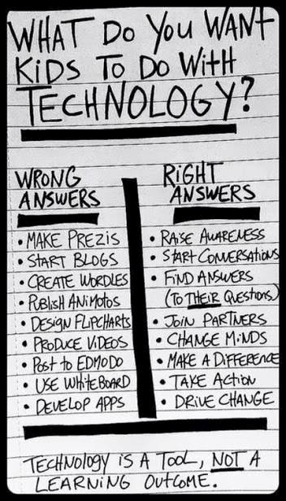

Slide 14
Working Memory
Read article
While reading:
Define working memory
Identify the two types of working memory
State why working memory is important

