Slide 1
Brainteaser games for kids are a fun way to learn and practice math and logic skills, critical thinking skills, and language skills. Students solve puzzles, search for hidden pictures, learn fun facts, master mazes, and solve whodunit mysteries. This helps students learn how to take turns, collaborate, be patient, work in groups, problem solve, all lifelong skills, through fun and play.
Whether it's video games, board games, or card games, playing a game requires a certain amount of skill. Learning a new game requires procedural memory and processing ability. Many games require strategy and use of complex logical reasoning. Many also require counting and even more complicated mathematical reasoning. Games played in groups require building social skills.

Slide 2
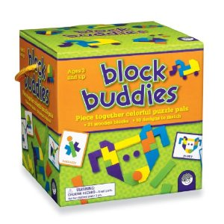
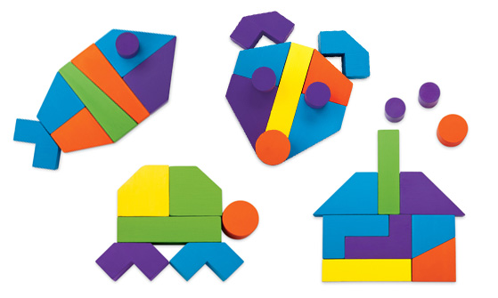
http://www.youtube.com/watch?v=a9AgBAbDCHQ

Slide 3
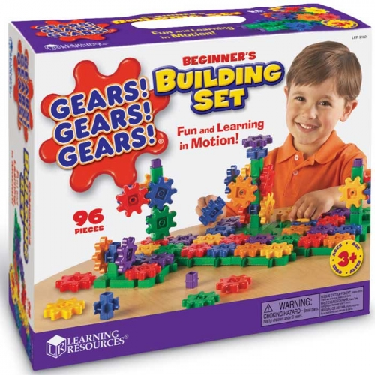
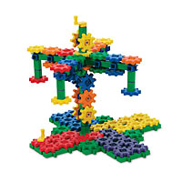
http://www.youtube.com/watch?v=y5PbnpM2zSA

Slide 4
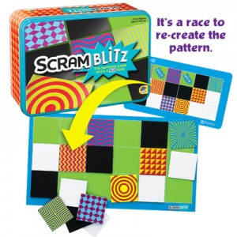
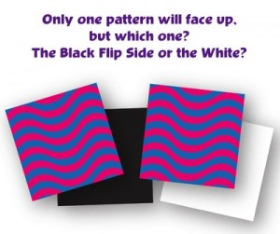
6 player
Each player takes a playing mat and chooses a set of pattern tiles (16 tiles with same shape cut-out in center).
Each player places their set in a random stack in front of them with mat.
Shuffled puzzle cards face down in center of all players.
Turn over first puzzle card
All players race to arrange their pattern tiles to recreate puzzle shown on card.
Each pair of patterned tiles in a set has either a black or white flip side. Which is the correct side to use? Choose the wrong one and your puzzle doesn’t work!
http://www.youtube.com/watch?v=-tZc1vK-Fvk

Slide 5
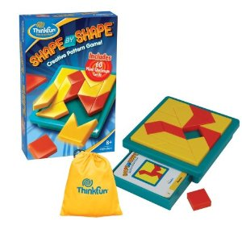
2 player (or work in teams of two).
Timer
Remove pieces from game bag.
Select a Challenge Card from deck.
All pieces MUST lie flat within the game tray.
You can turn or flip the pieces any way needed to complete the image.
Assemble the pieces to match the image on the card while other player keeps time.
ONLY if you get stuck: Hints on back of each Challenge Card.
HINT 1 shows the six red pieces that form the image.
HINT 2 shows the eight yellow pieces that form the background.

Slide 6
4 players
Paper and pencil
Strategically create lines of color and shape
Each player draws six tiles and places them face down
Each player reveals the highest number of tiles with similar attributes (either color or shape). The player with highest number starts the game.
After each turn draw tiles from bag to make six.
Scoring: one point for each tile in line you create (including existing tiles in line). Two points if part of two lines.
A Qwirkle is a line of six tiles which scores 6 points for the tiles and an additional 6 bonus points.
http://www.youtube.com/watch?v=BhNaJO8qDwA

Slide 7
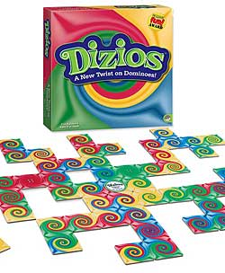
4 players, paper & pencils.
Each players draws 4 cards and places them on stands.
Begin by matching a tile to the edge of the starter tile.
Score by counting the dots on the tile matched to NOT the tile you placed.
Object to match tiles with the highest number of dots.
Continue until all tiles have been played.
The player with the highest score wins.
http://www.youtube.com/watch?v=_V5z0vfQzuM

Slide 8
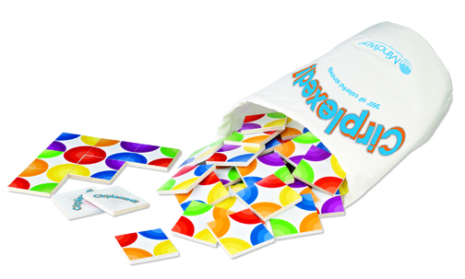
http://www.youtube.com/watch?v=uUIvuryV9Jo
Each player draws one tile from bag placing it face up in front of them. This is the starting tile for each player’s individual game board.
Each player then draws 2 more tiles without looking at them. Once all players have drawn, players look at their hand.
Everyone plays at the same time placing one tile at a time from their hand trying to match all colors if possible.
After each players tile is placed a new one is drawn from the bag so that each player always has 2 tiles to choose from.
Game is over when all tiles are drawn from bag and placed.
Players count the number of single color circles they created on their game board. The player with the most is the winner!

Slide 9
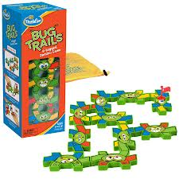
6 players
Each player draws 4 bug tiles.
Player to think of longest bug name goes first.
Player tries to match one of their bug tiles to the Bug Scout. A match is made by placing a bug tile so that AT LEAST one leg is touching a leg of the Bug Scout. All touching legs must be same color!
After placing a bug tile, a player’s turn is over and the flag is moved to the top of the bug just matched.
The first player to get rid of all their tiles is the winner!
Matching rules:
0 to 1 leg: player must draw another leg from bag.
2 legs: the player does not draw anymore legs from bag.
3 or more legs: player places one leg back in bug bag.
http://www.youtube.com/watch?v=cPnNVc6Z2w0

Slide 10
2 players (or work in teams of two).
Timer
Combine the pieces to match the image on the Challenge Card.
Remove the five puzzle pieces from bag and place on table.
Select Challenge Card from deck (cards are numbered and in order 1-60).
Assemble the pieces to match the image on the card while other player keeps time.

Slide 11
